Slide 1
Mob Programming
My first team

Slide 2
I am a software engineer with Hunter Industries. This slide deck represents my ideas, and my story.
It in no way represents the views and or opinions of Hunter Industries.

Slide 3

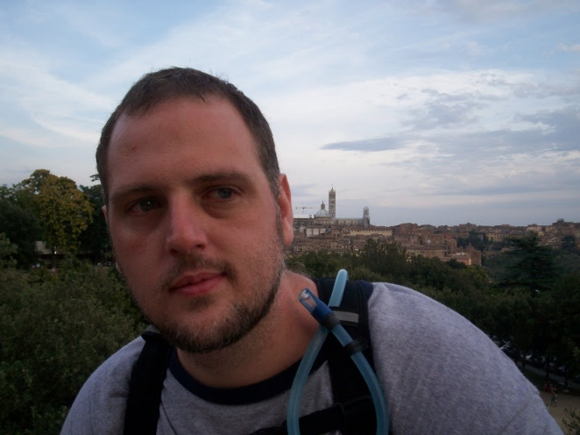
Who am I?
R. Jason Kerney
Lover of Code
Newer member
Agilist
Saving Code Wizard
Mob Programmer
Functional Programmer
(Learner)
@JasonKerney

Slide 4
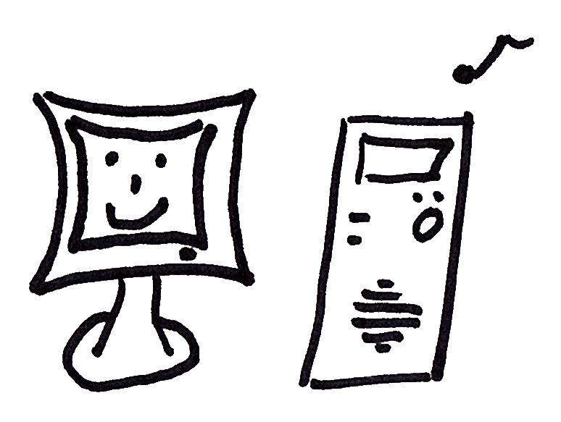
Overview
@JasonKerney

Slide 5
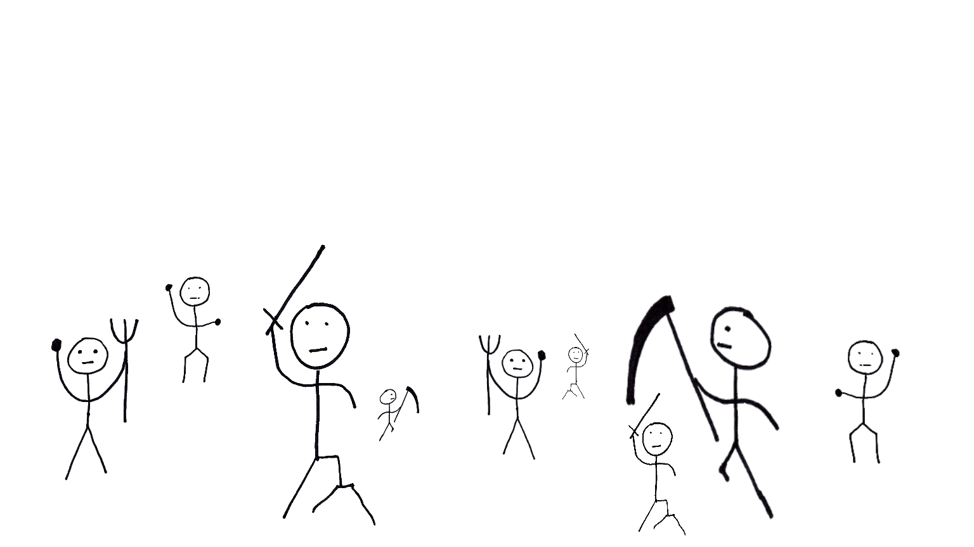
What is Mob-Programming?
@JasonKerney
All the people
working together
working
on the same thing,
on the same computer

Slide 6
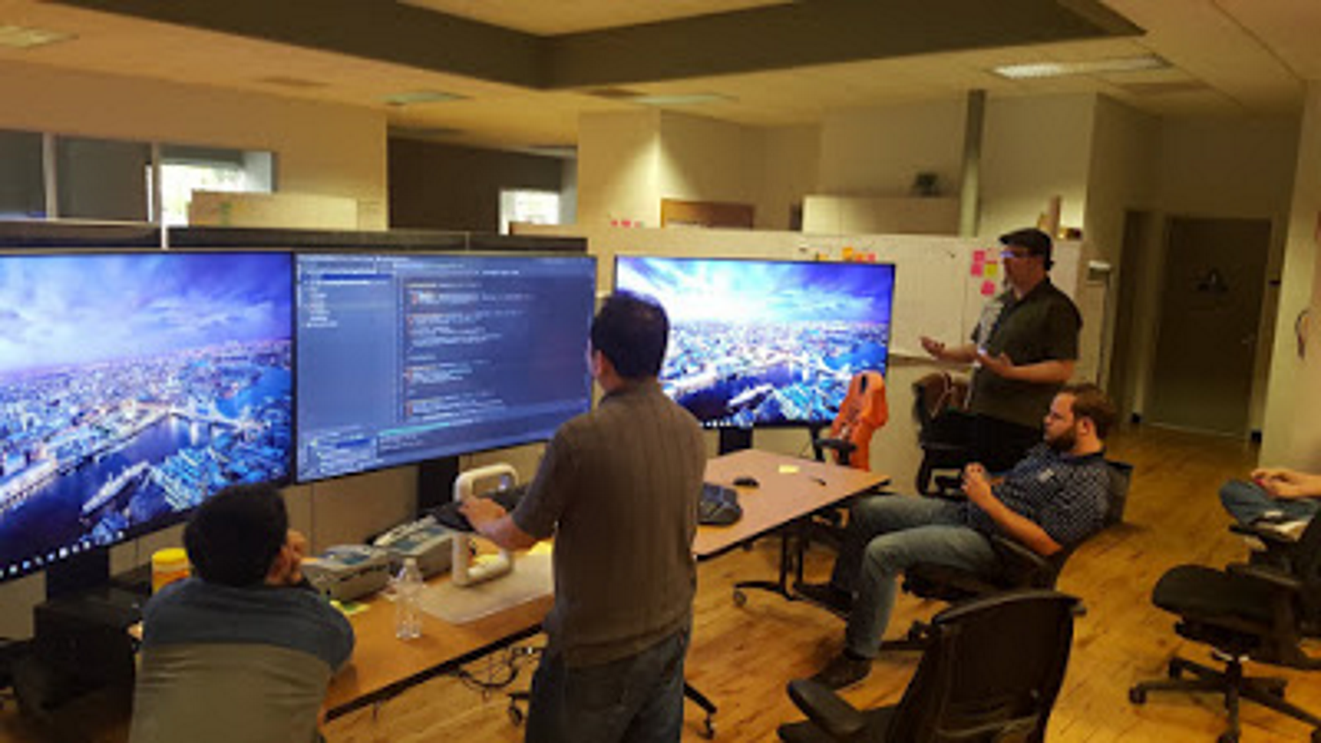

Slide 7
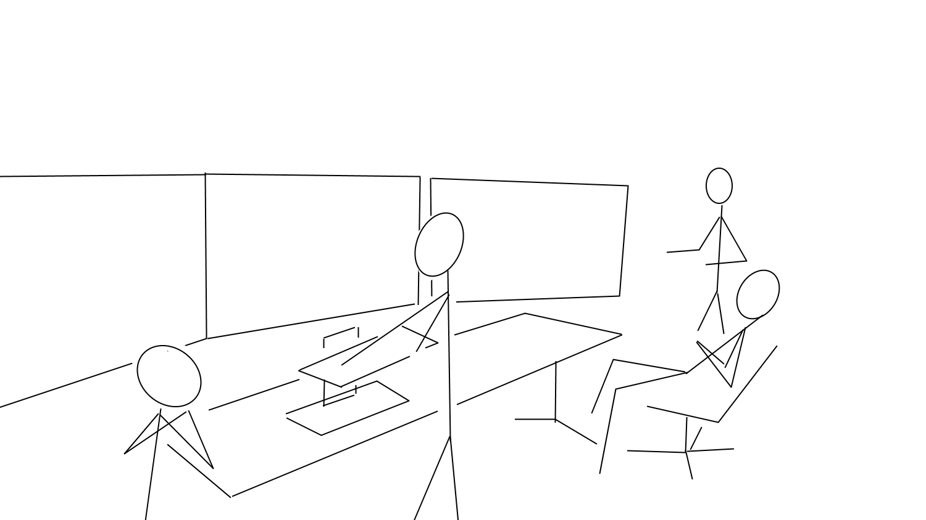

Slide 8
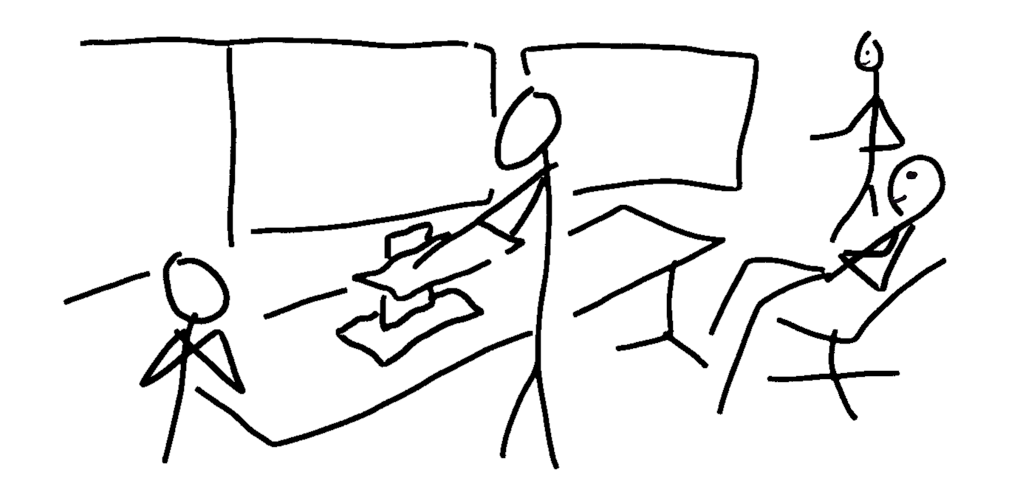

Slide 9
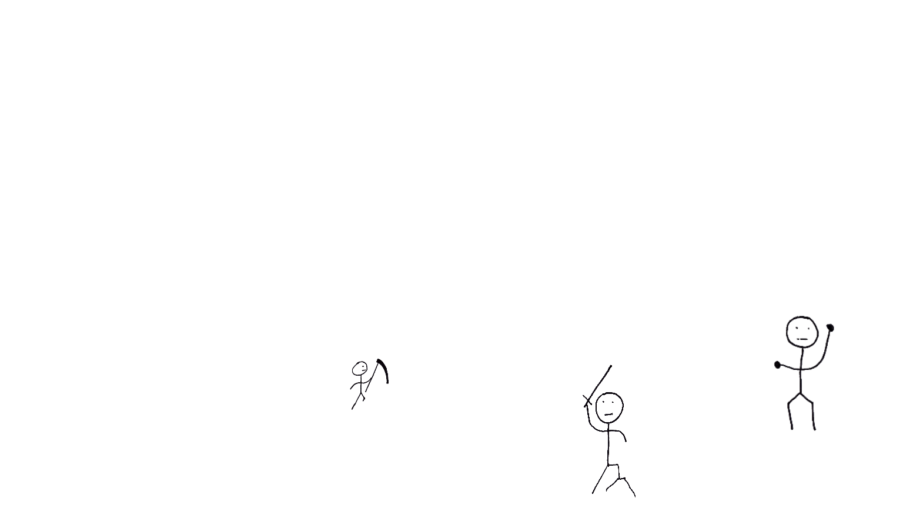
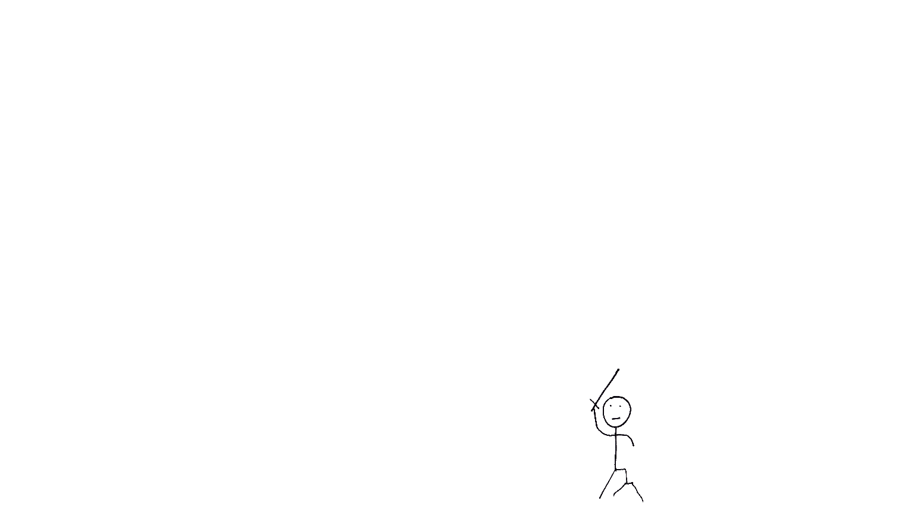
How we became a mob
@JasonKerney

Slide 10
Why we are a mob?
@JasonKerney
Because we want to be.

Slide 11

Rules
@JasonKerney
Show Kindness
Show Consideration
Show Respect
… At all Times

Slide 12
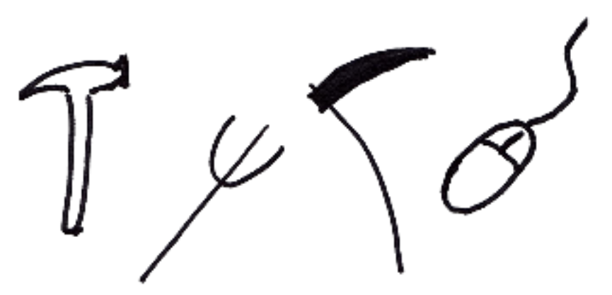
Tools
@JasonKerney
Tools

Slide 13
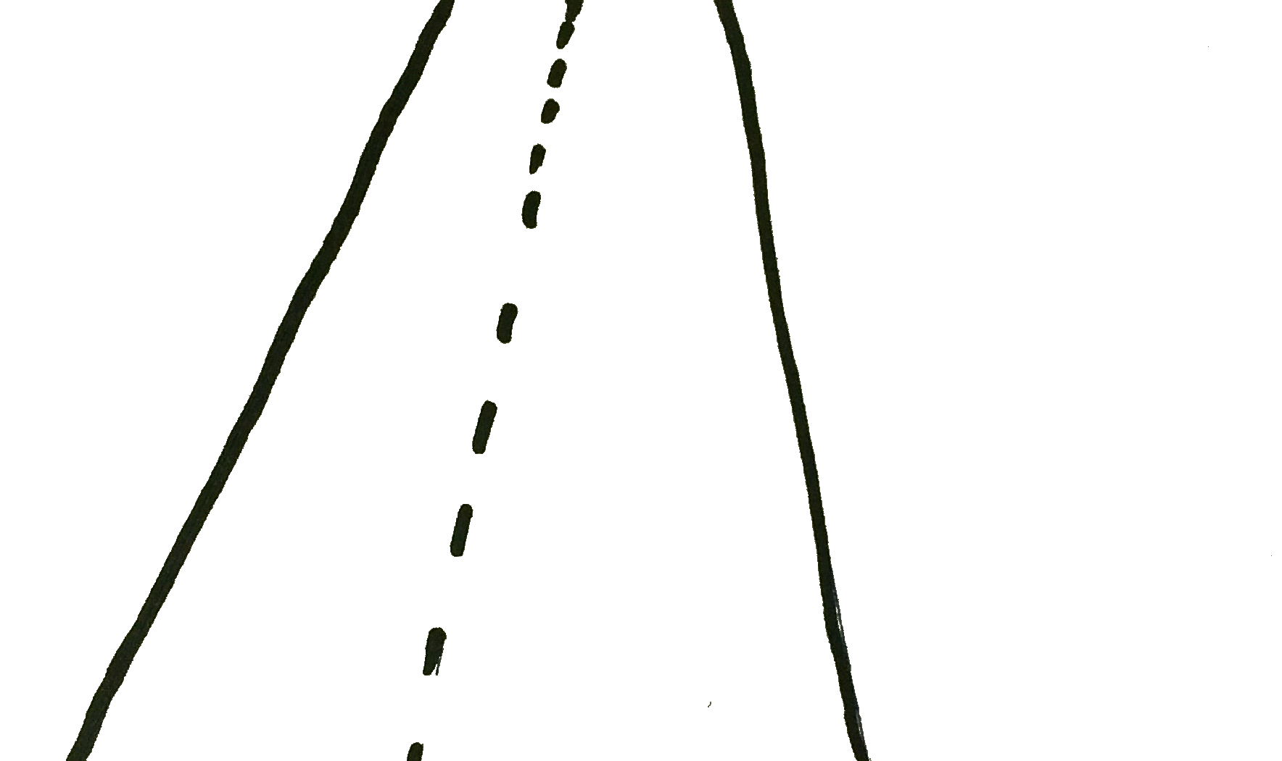
Guidelines
@JasonKerney

Slide 14
Guidelines
@JasonKerney
The Timer

Slide 15
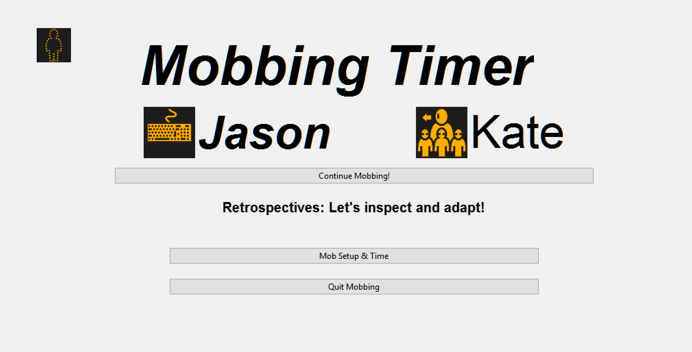
@JasonKerney
http://bit.ly/MobTimer

Slide 16
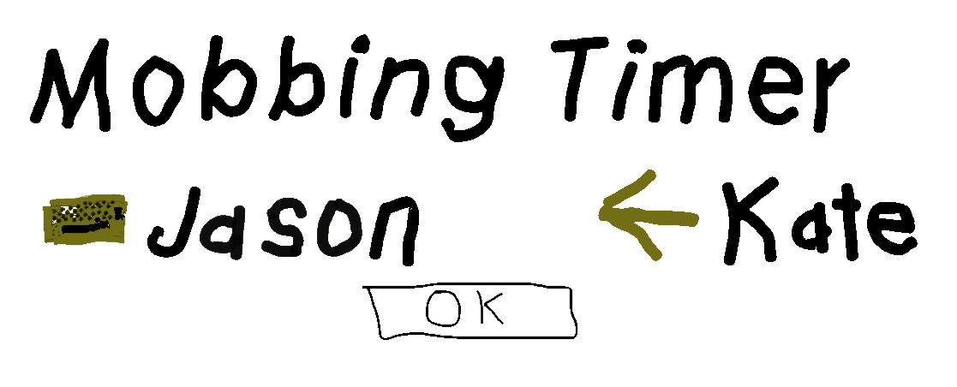
@JasonKerney

Slide 17
Guidelines
@JasonKerney
The Timer

Slide 18
Guidelines
@JasonKerney
The Timer
Driver Navigators

Slide 19
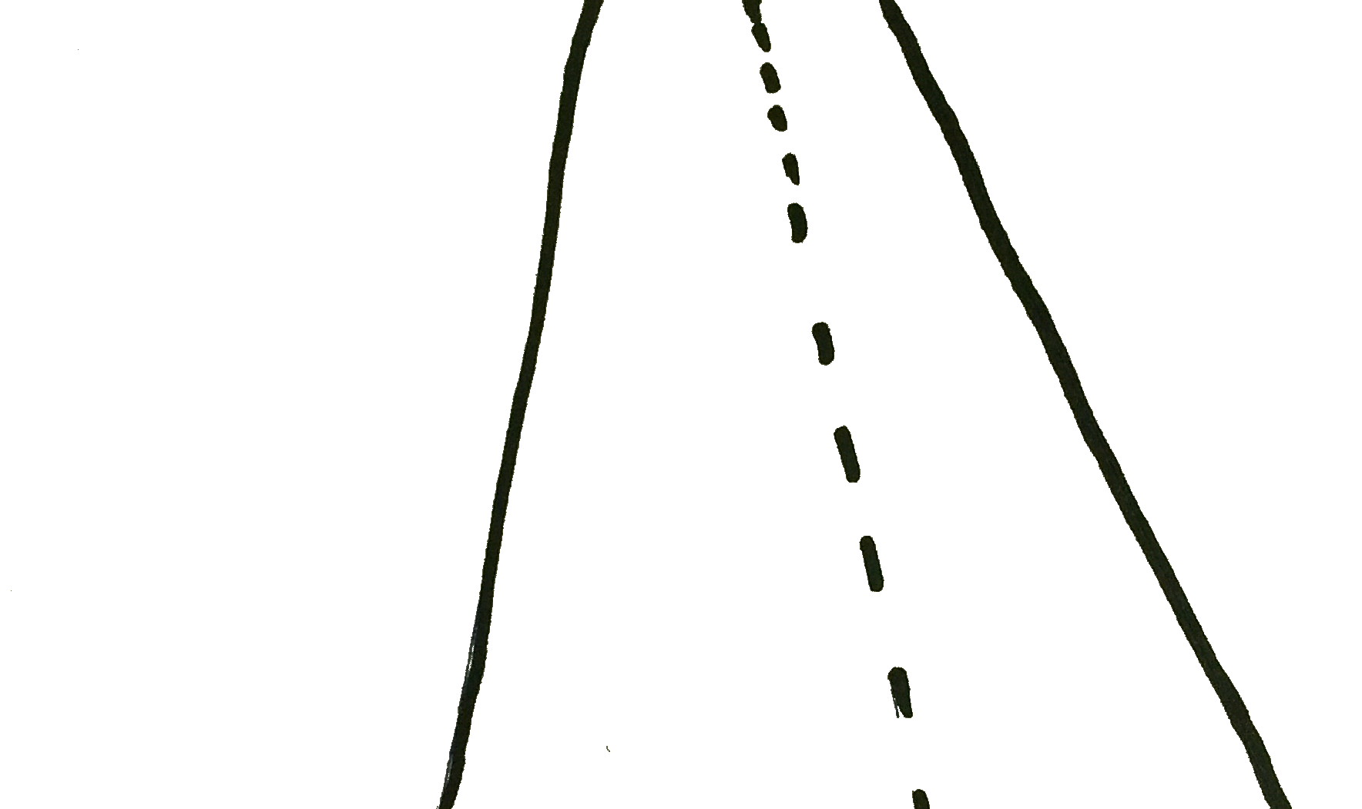
Guidelines
@JasonKerney
The Timer
Driver Navigators
Study Sessions

Slide 20
Guidelines
@JasonKerney
The Timer
Driver Navigators
Study Sessions
Automation

Slide 21
Guidelines
@JasonKerney
The Timer
Driver Navigators
Study Sessions
Automation
Guests / Visitors

Slide 22
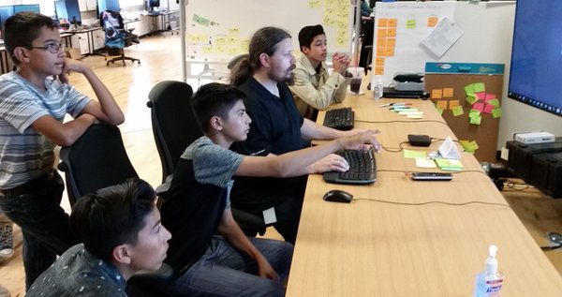

Slide 23
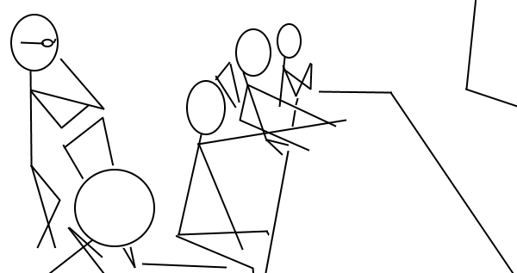

Slide 24
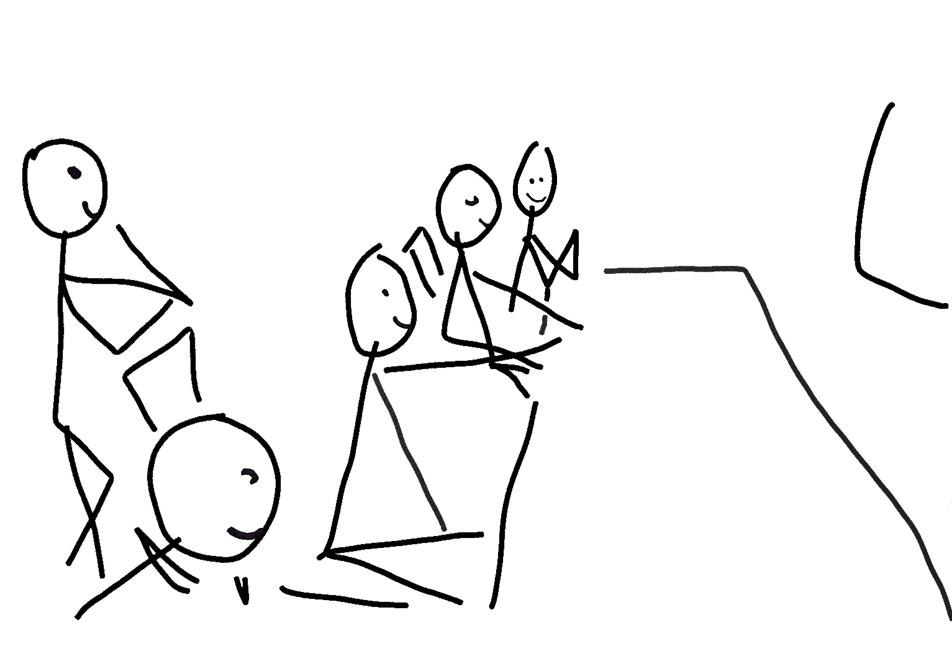

Slide 25
Guidelines
@JasonKerney
The Timer
Driver Navigators
Study Sessions
Automation
Guests / Visitors

Slide 26
Guidelines
@JasonKerney
The Timer
Driver Navigators
Study Sessions
Automation
Guests / Visitors

Slide 27
Guidelines
@JasonKerney
The Timer
Driver Navigators
Study Sessions
Automation
Guests / Visitors
Retrospect

Slide 28
Guidelines
@JasonKerney
The Timer
Driver Navigators
Study Sessions
Automation
Guests / Visitors
Retrospect

Slide 29






Learning as a team
@JasonKerney

Slide 30
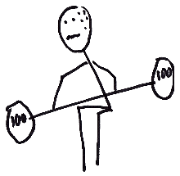
I Struggled
@JasonKerney

Slide 31
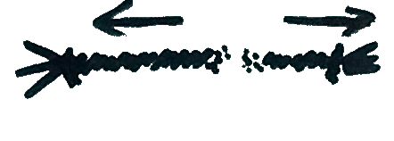
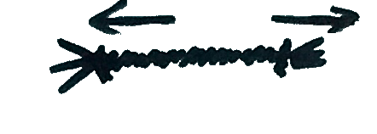
The importance of Slack
@JasonKerney

Slide 32
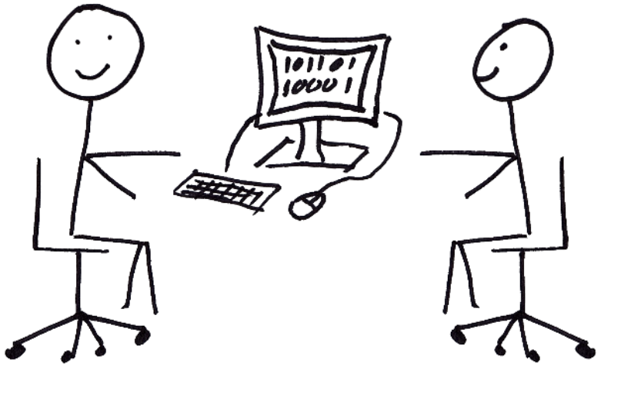
Not Advanced Pair Programming
@JasonKerney

Slide 33
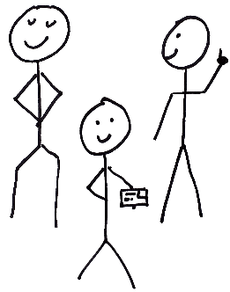
Real Teamwork
@JasonKerney

Slide 34
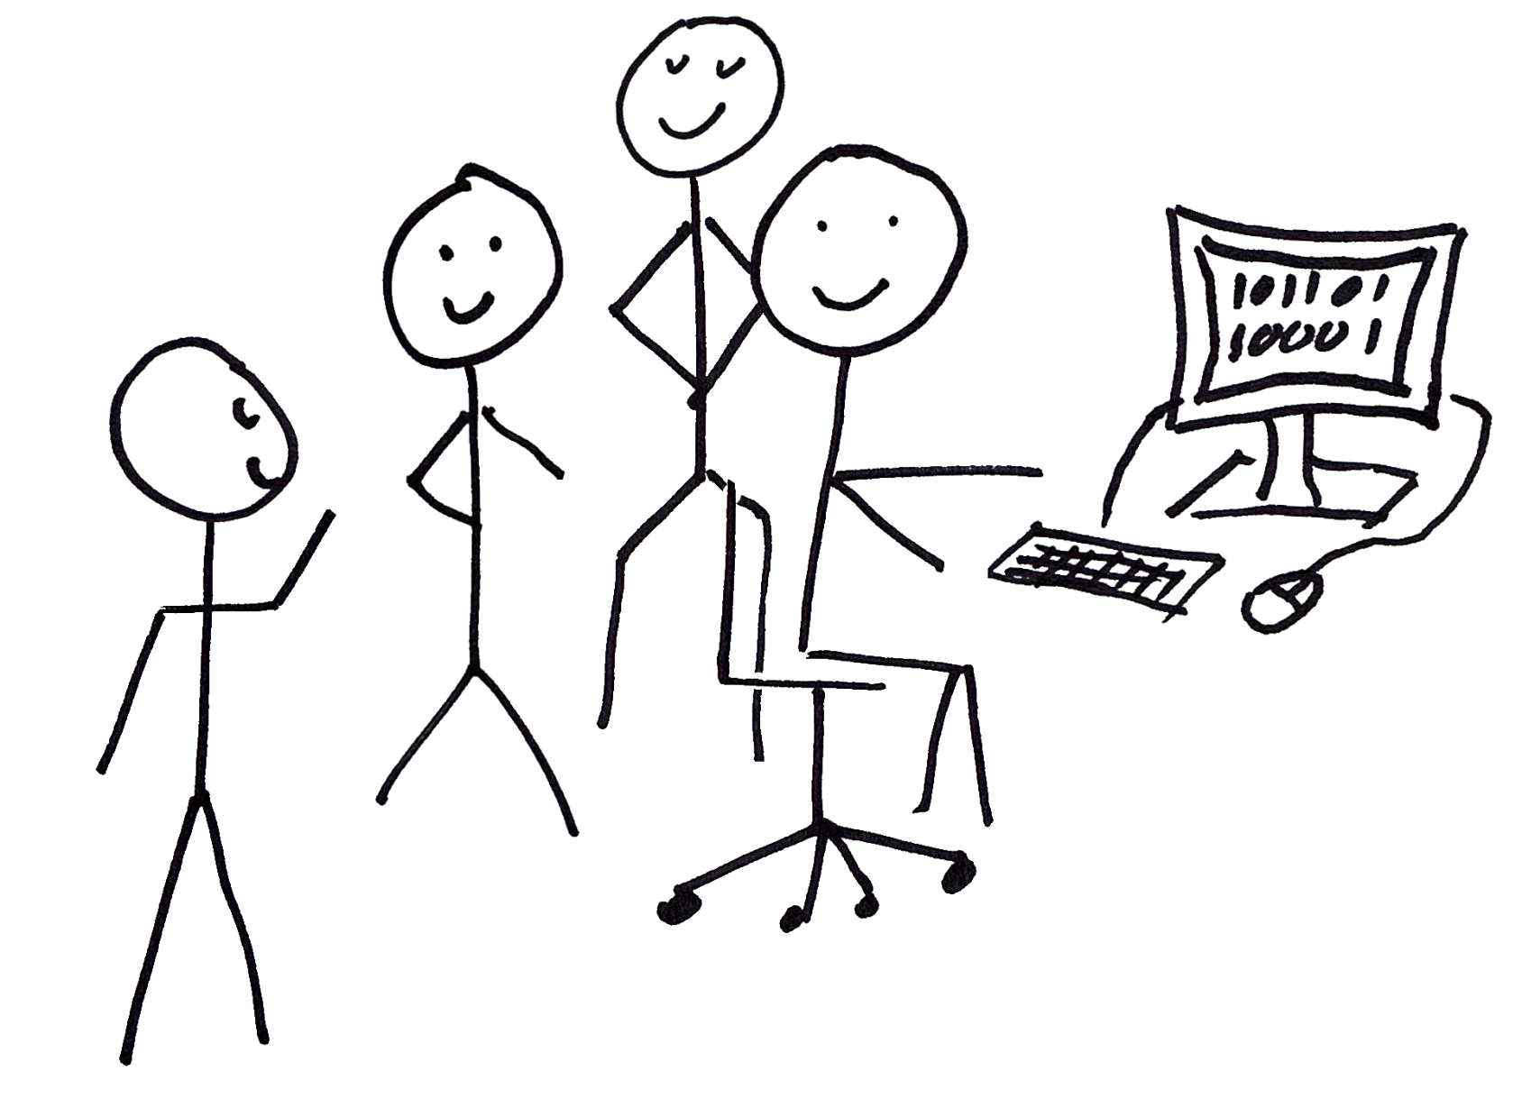
Interviewing
@JasonKerney

Slide 35
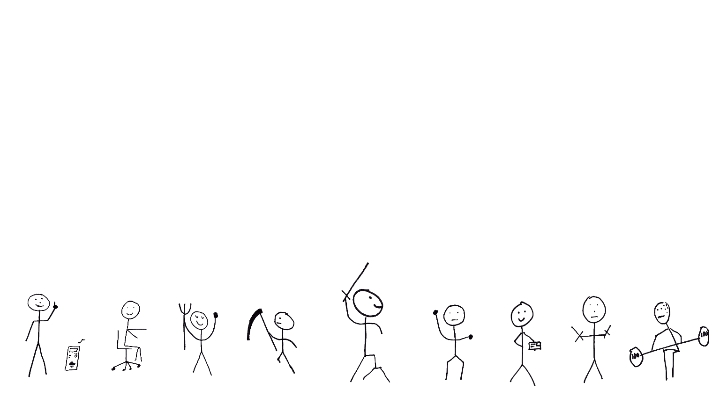
The Perfect Mob…
@JasonKerney

Slide 36
A Personal Note
@JasonKerney

Slide 37


Thank you Hunter
This talk represent my opinions, my story and my thoughts alone.

Slide 38
How to Find me
@JasonKerney
Twitter: @JasonKerney
Email: Jason+Mob@teamkerney.com
Blog: bit.ly/rjkBlog
Git Hub: bit.ly/rjkGitHub
Linked In: bit.ly/rjkIn
The Paper:
bit.ly/rjkFirstTeam

